Slide 1
Module 3: Chapter 5
IP as the IoT Network Layer

Slide 2
The Business Case for IP: This section discusses the advantages of IP from an IoT perspective and introduces the concepts of adoption and adaptation model.

Slide 3
The Business Case for IP : Things that collect information and then send it. Things that receive information and then act on it. Things that do both.
Data flowing from or to “things” is consumed, controlled, or monitored by data center servers either in the cloud or in locations that may be distributed or centralized.
Dedicated applications are then run over virtualized or traditional operating systems or on network edge platforms (for example, fog computing).
These lightweight applications communicate with the data
center servers.

Slide 4
Explain the key advantages of IP suite The Key Advantages of Internet Protocol
One of the main differences between traditional information technology (IT) and operational technology (OT) is the lifetime of the underlying technologies and products.
An entire industrial workflow generally mandates smooth, incremental steps that evolve, with operations itself being the most time- and mission-critical factor for an organization.
One way to guarantee multi-year lifetimes is to define a layered
architecture such as the 30-year-old IP architecture.
It is able to maintain its operations for large numbers of devices and users, such as the 3 billion Internet users

Slide 5
The key advantages of the IP suite for the Internet of Things are
Open and standards-based:
Versatile:
Ubiquitous:
Scalable
Manageable and highly secure:
Stable and resilient:
Consumers’ market adoption:
The innovation factor:

Slide 6
1.Open and standards-based: IETF standards - IP is an open standard which is not vendor specific and can suit IOT applications as IOT requires different devices to work together.
The Internet of Things creates a new paradigm in which devices,
applications, and
functionalities
users can
while
leverage a large set of devices and
and
guaranteeing interchangeability
interoperability, security, and management.
This calls for implementation, validation, and deployment of open, standards-based solutions.
While many standards development organizations (SDOs) are working on Internet of Things definitions, frameworks, applications, and technologies, none are questioning the role of the Internet Engineering Task Force (IETF) as the foundation for specifying and optimizing the network and transport layers.
The IETF is an open standards body that focuses on the development of the Internet Protocol suite and related Internet technologies and protocols

Slide 7
Versatile:
The layered IP architecture is well equipped to cope with any type of physical and data link layers. No single access technology can serve all IOT application, where there are various wired and wireless access technologies which can be used based on the type of the application and IP can cope with any of them.

Slide 8
3) Ubiquitous:
All recent operating system releases, from general-purpose computers and servers to lightweight embedded systems (TinyOS, Contiki, and so on), have an integrated dual (IPv4 and IPv6) IP stack that gets enhanced over time.
In addition, IoT application protocols in many industrial OT solutions have been updated in recent years to run over IP.
While these updates have mostly consisted of IPv4 to this point, recent standardization efforts in several areas are adding IPv6.
Example : self driving cars, smartphones.
In fact, IP is the most pervasive protocol when you look at what is
supported across the various IoT solutions and industry verticals.

Slide 9
4) Scalable:
As the common protocol of the Internet, IP has been massively deployed and tested for robust scalability.
Millions of private and public IP infrastructure nodes have been operational for years, offering strong foundations for those not familiar with IP network management.
Adding huge numbers of “things” to private and public infrastructures may require optimizations and design rules specific to the new devices.
However, you should realize that this is not very different from the recent evolution of voice and video endpoints integrated over IP.
IP has proven before that scalability is one of its strengths.

Slide 10
5) Manageable and highly secure: IP networks has a well-understood network management and security protocols, mechanisms, and toolsets that are widely available
Communications infrastructure requires appropriate management and security capabilities for proper operations.
One of the benefits that comes from 30 years of operational IP networks is the well-understood network management and security protocols, mechanisms, and toolsets that are widely available. Adopting IP network management also brings an operational business application to OT.
Well-known network and security management tools are easily
leveraged with an IP network layer.
However, you should be aware that despite the secure nature of IP, real challenges exist in this area.
The industry is challenged in securing constrained nodes,
handling legacy OT protocols, and scaling operations

Slide 11
6) Stable and resilient (to make sure your IoT device application remains active and performs as per specification):
IP has been around for 30 years, and it is clear that IP is a workable solution.
IP has a large and well-established knowledge base and, more importantly, it has been used for years in critical infrastructures, such as financial and defense networks.
In addition, IP has been deployed for critical services, such as voice and video, which have already transitioned from closed environments to open IP standards.
Finally, its stability and resiliency benefit from the large ecosystem of IT professionals who can help design, deploy, and operate IP- based solutions.

Slide 12
7) Consumers’ market adoption:
When developing IoT solutions and products targeting the consumer market, vendors know that consumers’ access to applications and devices will occur predominantly over broadband and mobile wireless infrastructure.
• The main consumer devices range from smart phones to tablets and PCs. The common protocol that links IoT in the consumer space to these devices is IP.

Slide 13
8) The innovation factor:
The past two decades have largely established the adoption of IP as a factor for increased innovation.
IP is the underlying protocol for applications ranging from file transfer and e-mail to the World Wide Web, e-commerce, social networking, mobility, and more.
Even the recent computing evolution from PC to mobile and mainframes to cloud services are perfect demonstrations of the innovative ground enabled by IP.
Innovations in IoT can also leverage an IP underpinning.

Slide 14
The adoption of IP provides a solid foundation for the Internet of Things by allowing secured and manageable bidirectional data communication capabilities between all devices in a network.
IP is a standards-based protocol that is ubiquitous, scalable, versatile, and stable.
Network services such as naming, time distribution, traffic prioritization, isolation, and so on are well-known and developed techniques that can be leveraged with IP.
From cloud, centralized, or distributed architectures, IP data flow can be developed and implemented according to business requirements

Slide 15
Adoption or Adaptation of the Internet Protocol
How to implement IP in data center, cloud services, and operation centers hosting IoT applications may seem obvious, but the adoption of IP in the last mile is more complicated and often makes running IP end-to-end more difficult.
Before IPv4 was widely accepted and deployed in IT networks, many different protocol stacks overlapped with IP.
For example, X.25/X.75 was standardized and promoted by service providers, while computer manufacturers implemented their own proprietary protocols, such as SNA, DECnet, IPX, and AppleTalk.

Slide 16
Adaptation means application layered gateways (ALGs) must be implemented to ensure the translation between non-IP and IP layers.
Application layered gateways (ALGs): It is a type of security software or device that acts on behalf of the application servers on a network, protecting the servers and applications from traffic that might be malicious.
Adoption involves replacing all non-IP layers with their IP layer counterparts, simplifying the deployment model and operations.

Slide 17
Explain the factors considered to determine select a model for last-mile connectivity ( Any technology that assists in delivering services directly to end users classified as Last Mile Technology)
Bidirectional versus unidirectional data flow:
Overhead for last-mile communications paths:
Data flow model:
Network diversity:

Slide 18
Bidirectional versus unidirectional data flow:
While bidirectional communications are generally expected, some last-mile technologies offer optimization for unidirectional communication.
IoT devices may only infrequently need to report a few bytes of data
to an application.
These sorts of devices, particularly ones that communicate through LPWA technologies, include fire alarms sending alerts or daily test reports, electrical switches being pushed on or off, and water or gas meters sending weekly indexes.
For these cases, it is not necessarily worth implementing a full IP stack.
It requires the overall end-to-end architecture to solve potential drawbacks; for example, if there is only one-way communication to upload data to an application, then it is not possible to download new software or firmware to the devices.

Slide 19
2) Overhead for last-mile communications paths:
IP adoption implies a layered architecture with a per-packet overhead that varies depending on the IP version.
IPv4 has 20 bytes of header at a minimum, and IPv6 has 40 bytes at the IP network layer. For the IP transport layer, UDP has 8 bytes of header overhead, while TCP has a minimum of 20 bytes.
If the data to be forwarded by a device is infrequent and only a few bytes, you can potentially have more header overhead than device data—again, particularly in the case of LPWA technologies.
Consequently, you need to decide whether the IP adoption model is necessary and, if it is, how it can be optimized.
This same consideration applies to control plane traffic that is run over
IP for low-bandwidth, last-mile links.

Slide 20
3) Data flow model:
One benefit of the IP adoption model is the end-to-end nature of communications.
Any node can easily exchange data with any other node in a network, although security, privacy, and other factors may put controls and limits on the “end-to-end” concept.
In many IoT solutions, a device’s data flow is limited to one or
two applications.
In this case, the adaptation model can work because translation of traffic needs to occur only between the end device and one or two application servers.

Slide 21
4) Network diversity:
One of the drawbacks of the adaptation model is a general dependency on single PHY and MAC layers. For example, ZigBee devices must only be deployed in ZigBee network islands.
This same restriction holds for ITU G.9903 G3-PLC nodes.
Therefore, a deployment must consider which applications have to run on the gateway connecting these islands and the rest of the world.
Integration and coexistence of new physical and MAC layers or new applications impact how deployment and operations have to be planned.

Slide 22
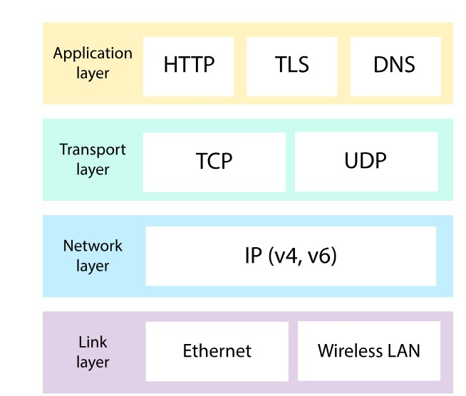
The Need for Optimization
optimizations are needed at various layers of the IP stack to handle the restrictions that are present in IoT networks.

Slide 23
Constrained Nodes
Another limit is that this network protocol stack on an IoT node may be required to communicate through an unreliable path.
Even if a full IP stack is available on the node, this causes problems such as limited or unpredictable throughput and low convergence when a topology change occurs.
Finally, power consumption is a key characteristic of constrained nodes.
To help extend battery life, you could enable a “low-power” mode instead of one that is “always on.”
Another option is “always off,” which means communications are enabled only when needed to send data.

Slide 24
IoT constrained nodes can be classified as follows:
Devices that are very constrained in resources, may communicate infrequently to transmit a few bytes, and may have limited security and management capabilities: This drives the need for the IP adaptation model, where nodes communicate through gateways and proxies.
Devices with enough power and capacities to implement a stripped- down IP stack or non-IP stack: In this case, you may implement either an optimized IP stack and directly communicate with application servers (adoption model) or go for an IP or non-IP stack and communicate through gateways and proxies (adaptation model).
Devices that are similar to generic PCs in terms of computing and power resources but have constrained networking capacities, such as bandwidth: These nodes usually implement a full IP stack (adoption model), but network design and application behaviors must cope with the bandwidth constraints.

Slide 25
Constrained Networks
In the early years of the Internet, network bandwidth capacity was restrained due to technical limitations.
Connections often depended on low-speed modems for transferring data.
However, these low-speed connections demonstrated that IP could run over low-bandwidth networks.
Fast forward to today, and the evolution of networking has seen the emergence of high-speed infrastructures. However, high-speed connections are not usable by some IoT devices in the last mile

Slide 26
Note
Constrained networks are often referred to as low-power and lossy networks (LLNs).
Lossy in this context refers to network unreliability that is caused by disruptions in the data flow or packet loss.
LLNs were defined by the IETF’s Routing over Low-Power and Lossy Networks (RoLL) working group when developing the IPv6 RPL protocol.
An IETF working group is an open discussion group of individuals in a particular technology area. They have a charter that defines their focus and what they are expected to produce.

Slide 27
Constrained networks have unique characteristics and requirements.
In contrast with typical IP networks, where highly stable and fast links are available, constrained networks are limited by low-power, low-bandwidth links (wireless and wired).
They operate between a few kbps and a few hundred kbps and may utilize a star, mesh, or combined network topologies, ensuring proper operations.
Large bursts of unpredictable errors and even loss of connectivity at times may occur.
These behaviors can be observed on both wireless and narrowband power-line communication links, where packet delivery variation may fluctuate greatly during the course of a day.

Slide 28
Unstable link layer environments create other challenges in terms of latency and control plane reactivity.
One of the golden rules in a constrained network is to “underreact to failure.” Due to the low bandwidth, a constrained network that overreacts can lead to a network collapse—which makes the existing problem worse.
Control plane traffic must also be kept at a minimum; otherwise, it consumes the bandwidth that is needed by the data traffic.
Finally, you have to consider the power consumption in battery-powered nodes. Any failure or verbose control plane protocol may reduce the lifetime of the batteries
In summary, constrained nodes and networks pose major challenges for IoT connectivity in the last mile.
This in turn has led various standards organizations to work on optimizing protocols for IoT

Slide 29
IP Versions
The following are some of the main factors applicable to IPv4 and IPv6 support in an IoT solution:
Application Protocol: IoT devices implementing Ethernet or Wi-Fi interfaces can communicate over both IPv4 and IPv6, but the application protocol may dictate the choice of the IP version
For IoT devices with application protocols defined by the IETF, such as HTTP/HTTPS, CoAP (constraint Application protocol), MQTT(Message Queuing Telemetry Transport), and XMPP, both IP versions are supported.

Slide 30
2) Cellular Provider and Technology:
IoT devices with cellular modems are dependent on the generation of the cellular technology as well as the data services offered by the provider.
For the first three generations of data services—GPRS, Edge, and 3G—IPv4 is the base protocol version.
Consequently, if IPv6 is used with these generations, it must be tunneled over IPv4.
On 4G/LTE networks, data services can use IPv4 or IPv6 as a base protocol, depending on the provider.

Slide 31
3. Serial Communications: Many legacy devices in certain industries such as manufacturing and utilities communicate via serial lines . The serial port of the legacy device need to be connected to nearby serial port on a piece of communication equipment typically a router. This local router then forwards the serial traffic over IP to the central server for processing.
4. IPv6 Adaptation Layer:
Some physical and data link layers for recently standardized IOT protocols supports only IPv6
Most common physical and data link layers like (Ethernet, Wi-Fi, and so on) stipulate adaptation layers for both the versions.
Newer technologies like IEEE 802.15.4,IEEE 190.1.2 only have an IPv6 adaptation layer specified.

Slide 32
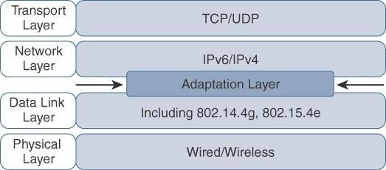
Optimizing IP for IoT
Figure 5-1 Optimizing IP for IoT Using an Adaptation Layer

Slide 33
From 6LoWPAN to 6Lo
In the IP architecture, the transport of IP packets over any given Layer 1 (PHY) and Layer 2 (MAC) protocol must be defined and documented.
The model for packaging IP into lower-layer protocols is often
referred to as an adaptation layer (it acts as a filter)- provides efficient header compression mechanisms avoiding information redundancy to dramatically reduce the IP overhead headers to a few bytes.
Unless the technology is proprietary, IP adaptation layers are typically defined by an IETF working group and released as a Request for Comments (RFC).
An RFC is a publication from the IETF that officially documents Internet standards, specifications, protocols, procedures, and events.
For example, RFC 864 describes how an IPv4 packet gets encapsulated over an Ethernet frame, and RFC 2464 describes how the same function is performed for an IPv6 packet.

Slide 34
IoT-related protocols follow a similar process. The main difference is that an adaptation layer designed for IoT may include some optimizations to deal with constrained nodes and networks
The main examples of adaptation layers optimized for constrained nodes or “things” are the ones under the 6LoWPAN working group and its successor, the 6Lo working group.
– The initial focus of the 6LoWPAN working group was to optimize the transmission of IPv6 packets over constrained networks such as IEEE 802.15.4.

Slide 35
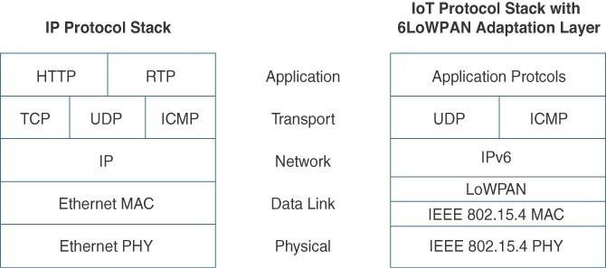
Figure 5-2 Comparison of an IoT Protocol Stack Utilizing 6LoWPAN and an IP Protocol Stack

Slide 36
The 6LoWPAN working group published several RFCs, but RFC 4994 is foundational because it defines frame headers for the capabilities of header compression, fragmentation, and mesh addressing.
These headers can be stacked in the adaptation layer to keep these concepts separate while enforcing a structured method for expressing each capability.
Depending on the implementation, all, none, or any combination of these capabilities and their corresponding headers can be enabled. Figure 5-3 shows some examples of typical 6LoWPAN header stacks.

Slide 37
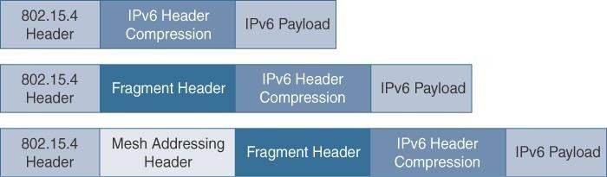
• Figure 5-3 6LoWPAN Header Stacks
• Figure 5-3 shows the subheaders related to compression, fragmentation, and mesh addressing
Figure 5-3 6LoWPAN Header Stacks
Figure 5-3 shows the subheaders related to compression, fragmentation, and mesh addressing

Slide 38
Header Compression
IPv6 header compression for 6LoWPAN was defined initially in RFC
4944 and subsequently updated by RFC 6282.
This capability shrinks the size of IPv6’s 40-byte headers and User Datagram Protocol’s (UDP’s) 8-byte headers down as low as 6 bytes combined in some cases.
At a high level, 6LoWPAN works by taking advantage of shared information known by all nodes from their participation in the local network.
In addition, it omits some standard header fields by assuming commonly used values. Figure 5- 4 highlights an example that shows the amount of reduction that is possible with 6LoWPAN header compression.

Slide 39
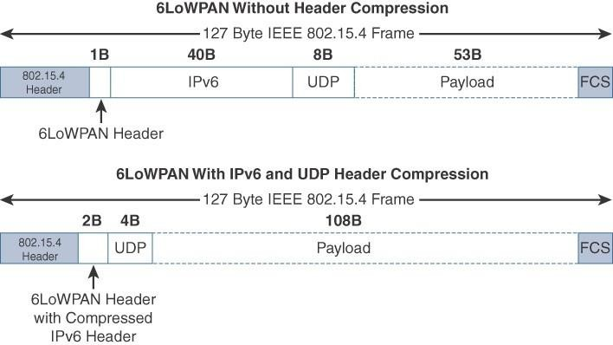
Figure 5-4 6LoWPAN Header Compression
Note that the 2-byte header compression applies to intra- cell communications, while communications external to the cell may require some field of the header to not be compressed.

Slide 40
Fragmentation
The maximum transmission unit (MTU) for an IPv6 network
must be at least 1280 bytes.
The term MTU defines the size of the largest protocol data unit that can be passed.
For IEEE 802.15.4, 127 bytes is the MTU.
You can see that this is a problem because IPv6, with a much larger MTU, is carried inside the 802.15.4 frame with a much smaller one.
To remedy
this situation, large IPv6 packets must be
fragmented across multiple 802.15.4 frames at Layer 2

Slide 41
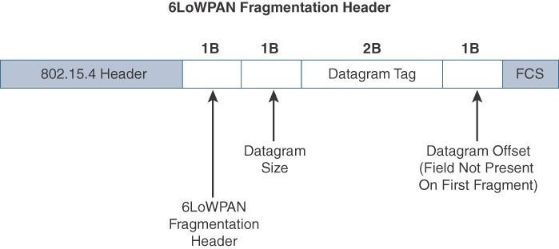
Figure 5-5 6LoWPAN Fragmentation Header
three primary fields: Datagram Size, Datagram Tag, and Datagram Offset.
The 1-byte Datagram Size field specifies the total size of the unfragmented payload.
Datagram Tag identifies the set of fragments for a payload.
Finally, the Datagram Offset field datagram-offset indicates the offset of the fragment from the first fragment (delineates how far into a payload a particular fragment occurs).

Slide 42
Mesh Addressing
The purpose of the 6LoWPAN mesh addressing function is to
forward packets over multiple hops.
Three fields are defined for this header: Hop Limit, Source
Address, and Destination Address.
Analogous to the IPv6 hop limit field, the hop limit for mesh addressing also provides an upper limit on how many times the frame can be forwarded. Each hop decrements this value by 1 as it is forwarded. Once the value hits 0, it is dropped and no longer forwarded.
The Source Address and Destination Address fields for mesh addressing are IEEE 802.15.4 addresses indicating the endpoints of an IP hop

Slide 43
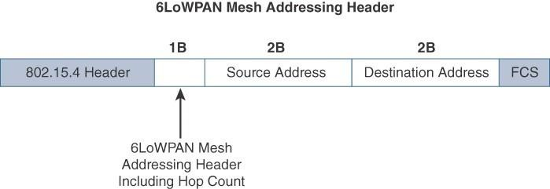
Figure 5-6 6LoWPAN Mesh Addressing Header

Slide 44
Mesh-Under Versus Mesh-Over Routing
Two main options exist for establishing reachability and forwarding packets.
mesh-under –forwarding and routing operations performed in layer2
The routing of packets is handled at the 6LoWPAN adaptation layer.
“mesh-over” or “route-over,” -forwarding and routing operations performed in layer3 (based on IP)
Utilizes IP routing for getting packets to their destination

Slide 45
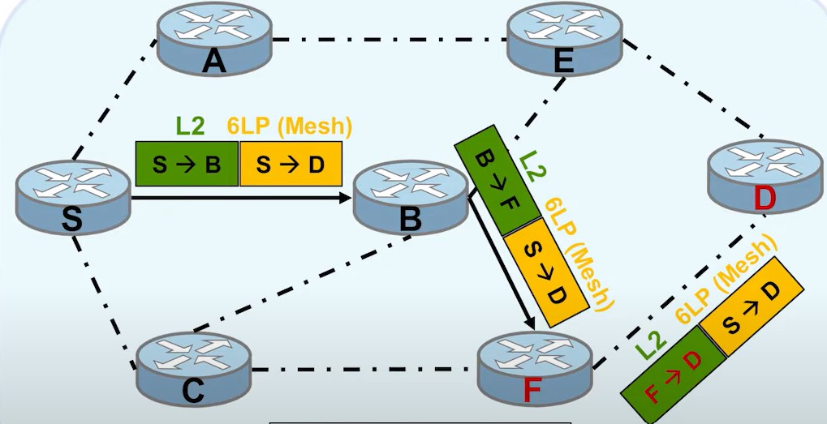

Slide 46
With mesh-under routing, the routing of IP packets leverages the 6LoWPAN mesh addressing header to route and forward packets at the link layer.
The term mesh-under is used because multiple link layer hops
can be used to complete a single IP hop.
Nodes have a Layer 2 forwarding table that they consult to route the packets to their final destination within the mesh.
An edge gateway terminates the mesh-under domain.
The edge gateway must also implement a mechanism to translate between the configured Layer 2 protocol and any IP routing mechanism implemented on other Layer 3 IP interfaces.

Slide 47
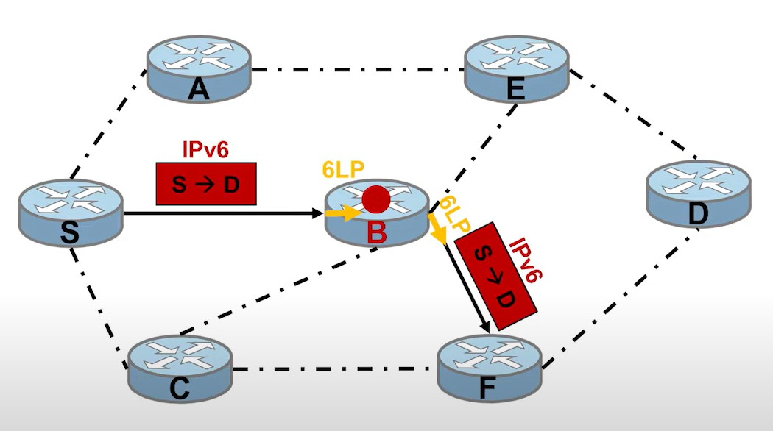

Slide 48
In mesh-over or route-over scenarios, IP Layer 3 routing is utilized for computing reachability and then getting packets forwarded to their destination,either inside or outside the mesh domain.
Each full-functioning node acts as an IP router, so each link layer hop is an IP hop.
When a LoWPAN has been implemented using different link layer technologies, a mesh-over routing setup is useful.
While traditional IP routing protocols can be used, a specialized routing protocol for smart objects, such as RPL, is recommended.

Slide 49
6Lo Working Group
Focus on IPv6 connectivity over constrained-node networks
This working group is focused on the following:
IPv6-over-foo adaptation layer specifications using 6LoWPAN technologies (RFC4944, RFC6282, RFC6775) for link layer technologies: For example, this includes:
IPv6 over Bluetooth Low Energy
Transmission of IPv6 packets over near-field communication IPv6 over 802.11ah
Transmission of IPv6 packets over DECT Ultra Low Energy
Transmission of IPv6 packets on WIA-PA (Wireless Networks for
Industrial Automation–Process Automation)
Transmission of IPv6 over Master Slave/Token Passing (MS/TP)

Slide 50
Information and data models such as MIB modules:
One example is RFC 7388, “Definition of Managed Objects for IPv6
over Low-Power Wireless Personal Area Networks (6LoWPANs).”
Optimizations that are applicable to more than one adaptation layer specification:
For example, this includes RFC 7400, “6LoWPAN-GHC: Generic Header Compression for IPv6 over Low-Power Wireless Personal Area Networks (6LoWPANs).”
Informational and maintenance publications needed for the IETF specifications in this area

Slide 51
6TiSCH – IPv6 Time slot channel hopping
The 6TiSCH architecture defines four schedule management mechanisms:
Static scheduling: All nodes in the constrained network share a fixed schedule. Cells are shared, and nodes contend for slot access in a slotted aloha manner.
Static scheduling is a simple scheduling mechanism that can be used upon initial implementation or as a fallback in the case of network malfunction. The drawback with static scheduling is that nodes may expect a packet at any cell in the schedule. Therefore, energy is wasted idly listening across all cells.
2. Neighbor-to-neighbor scheduling: A schedule is established that correlates with the observed number of transmissions between nodes. Cells in this schedule can be added or deleted as traffic requirements and bandwidth needs change.
3. Remote monitoring and scheduling management: Time slots and other resource allocation are handled by a management entity that can be multiple hops away.
4. Hop-by-hop scheduling: A node reserves a path to a destination node
multiple hops away by requesting the allocation of cells in a schedule at
each intermediate node hop in the path.

Slide 52
In addition to schedule management functions, the 6TiSCH architecture also defines three different forwarding models. Forwarding is the operation performed on each packet by a node that allows it to be delivered to a next hop or an upper-layer protocol.
Track Forwarding (TF): This is the simplest and fastest forwarding model. A “track” in this model is a unidirectional path between a source and a destination. This track is constructed by pairing bundles of receive cells in a schedule with a bundle of receive cells set to transmit. So, a frame received within a particular cell or cell bundle is switched to another cell or cell bundle. This forwarding occurs regardless of the network layer protocol.
Fragment forwarding (FF): A mechanism is defined where the first fragment is routed based on the IPv6 header present. The 6LoWPAN sublayer learns the next-hop selection of this first fragment, which is then applied to all subsequent fragments of that packet. Otherwise, IPv6 packets undergo hop-by-hop reassembly. This increases latency and can be power- and CPU-intensive for a constrained node.
IPv6 Forwarding (6F): This model forwards traffic based on its IPv6 routing table. Flows of packets should be prioritized by traditional QoS (quality of service) and RED (random early detection) operations. QoS is a classification scheme for flows based on their priority, and RED is a common congestion avoidance mechanism.

Slide 53
RPL(Routing protocol for Low power and Lossy networks
RPL is a new routing protocol that enables an IPv6 standards based solution to be deployed on a large scale while being operated in a similar way to today’s IP infrastructures. Metrics are a set of constraints and rules used by RPL routing and defined in RFC 6551. Metrics include the following:
1.Expected Transmission Count (ETX): Assigns a discrete value to the number of transmissions a node expects to make to deliver a packet.
2. Hop Count: Tracks the number of nodes traversed in a path. Typically, a path with a lower hop count is chosen over a path with a higher hop count.
3. Latency: Varies depending on power conservation. Paths with a lower latency are preferred.
4. Link Quality Level: Measures the reliability of a link by taking into account packet error rates caused by factors such as signal attenuation and interference.

Slide 54
5. Link Color: Allows manual influence of routing by administratively setting values to make a link more or less desirable. These values can be either statically or dynamically adjusted for specific traffic types.
6. Node State and Attribute: Identifies nodes that function as traffic aggregators and nodes that are being impacted by high workloads. High workloads could be indicative of nodes that have incurred high CPU or low memory states. Naturally, nodes that are aggregators are preferred over nodes experiencing high workloads.
7. Node Energy: Avoids nodes with low power, so a battery-powered node that is running out of energy can be avoided and the life of that node and the network can be prolonged.
8. Throughput: Provides the amount of throughput for a node link. Often, nodes conserving power use lower throughput. This metric allows the prioritization of paths with higher throughput.

